Slide 1
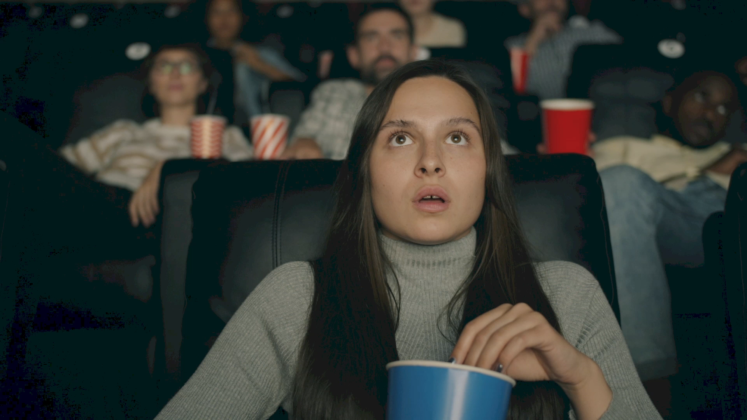
Unlocking The Thrill a tale of movie trailers vs. movie teasers
By Soteria Ebulu

Slide 2

Introduction
In the realm of cinema, anticipation is a key ingredient in the recipe for success.
Movie teasers, or enticing previews into upcoming films, have enormous potential to capture fans' imaginations around the world.
But what distinguishes a teaser from a trailer? Join us on a journey as we delve into the facts behind these two and learn the secrets of their thrill.

Slide 3

What distinguishes two?
A movie teaser lets you know in less than 30 seconds that something is coming soon.
A movie trailer lasts 1 to 2 minutes and tries to tell you to take action.

Slide 4

The audience
Film makers often wonder what would increase the amount viewers to watch their movies and it could be either of the two.
- The engagement of movie enthusiasts while watching teasers and trailers

Slide 5

The film being used for this analysis is Velma. The data provided had movie trailers and teasers of the Velma movie under the film and animation category.
01
A couple of youtubers created videos about the new release on HBO. Some gave their honest reviews, both positive and negative and other YouTube channels had the trailer and teaser for the movie.
02
With the engagement on all these YouTube videos, I became intrigued by the difference in the number of views and likes each video had.
03

Slide 6
Table of engagements
YOUTUBE VIDEOS | SUM OF VIEW COUNT | SUM OF LIKES | SUM OF DISLIKES | SUM OF COMMENTS
Honest Trailers Velma | 6,736,142 | 339,207 | 0 | 37,478
Ok, Velma is worse than I thought | 3,838,602 | 201,301 | 0 | 32,767
Velma Official Teaser HBO | 8,204,059 | 143,048 | 0 | 96,113
Velma Official Trailer HBO | 31,198,652 | 45,812 | 0 | 0

Slide 10
The official trailer had the most engagements even with a disabled comment section.

Slide 11

From the graphical representation, it is clear that movie trailers have more views than the rest.
The teaser was what brought the attention of movie enthusiasts to anticipate the movie, while the trailer gave more details on what to expect.
The video with least views (“ Ok, Velma was worse than I thought”) and engagement in total was the negative review but still had engagements when it came to comments.
All engagement is good engagement for film makers.

Slide 12
Conclusion of findings
With the given data provided, what film makers need to do to improve views on their films is to incorporate hashtags when promoting.
Naturally, films are promoted by movie enthusiasts who like films.
- films can be promoted through YouTube reviews
- written articles
- live streaming.
- Social media influencers ( some of the reviews made were from social media influencers).

